Slide 1
Section 404 Permits
ENVE 644 – Environmental Management and Permitting
Marc Frutiger, PE, PTOE

Slide 2
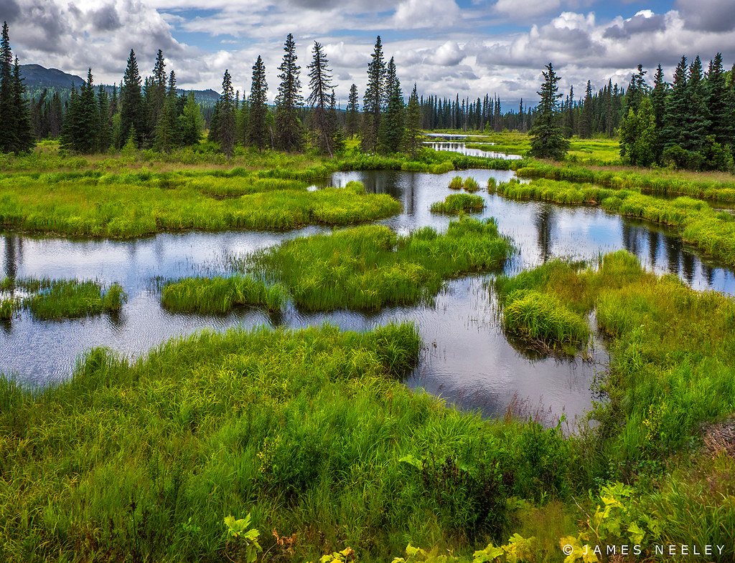
Outline
Background
Jurisdiction
Types of Permits
Application process
References
Q&A
Notes:
We’ve heard a lot about this topic
USACOE likes the application to do most of the work, let them review/comment/approve
Almost every project I work on includes wetlands, since a large portion of AK is covered in wetlands

Slide 3
Background
The Clean Water Act (CWA) establishes the basic structure for regulating discharges of pollutants into the waters of the United States (WOTUS) and regulating quality standards for surface waters. The basis of the CWA was enacted in 1948 and was called the Federal Water Pollution Control Act, but the Act was significantly reorganized and expanded in 1972. "Clean Water Act" became the Act's common name with amendments in 1972.
US Army Corps of Engineers (USACOE) has authority to administer section 404 of the CWA.
USACOE issues permits to place fill or dredge material in WOTUS
Notes:
Ellen told us about background of CWA, USACOE’s mission, section 10 and 404 permits, types of permits, etc.
Cameron gave a nice talk last week on the controversy surrounding WOTUS

Slide 4
Background (cont’d)
The regulated activities typically requiring a section 404 permit include:
Discharging dredged or fill material in waters of the U.S., including wetlands;
Site improvement fill for residential, commercial, or recreational development;
Construction of revetments, breakwaters, levees, dams, dikes, and weirs; and
Placement of riprap and fill material for roads, airports, or buildings.

Slide 5
Jurisdiction
Notes:
Section 10: navigability (Sophie, previous presentation)
Section 404: restore and maintain the physical, chemical, and biological integrity of the nation’s waters

Slide 6
Types of Permits
Nationwide
General conditions
Regional conditions
Regional General
Letters of Permission
Not AK
Individual Permits
Alternative Permits
Not AK
Other considerations
Notes:
Nationwide permits authorize specific activities in areas under Corps’ Regulatory jurisdiction. These activities are minor in scope and must result in no more than minimal adverse impacts, both individually and cumulatively. Individuals wishing to perform work under a nationwide permit must ensure their project meets all applicable terms and conditions, including the regional conditions specific to Alaska. If the conditions cannot be met, a regional general permit or individual permit will be required.
Regional General Permits (GPs) are issued by the Alaska District Corps of Engineers. Some GPs authorize specific activities statewide, while others are specific to certain regions in Alaska. GPs can only authorize activities or categories of activities that have minimal impacts both individually and cumulatively.
Flood hazard permits are often associated with fill placement

Slide 7
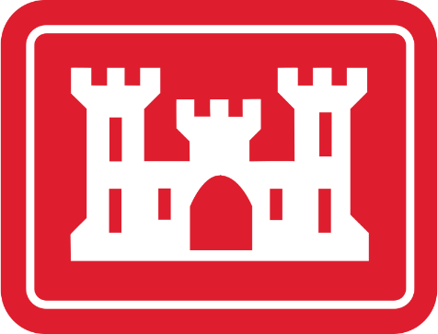
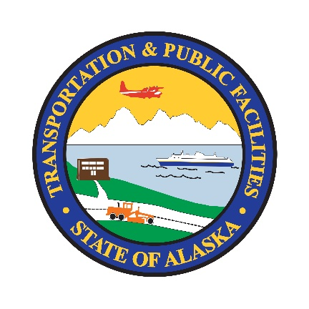
Application Process
Planning
Class of Action
Enviro
Wetlands Delineation, Functions, and Values Assessment
Scoping
Design
Develop project footprint
Permitting
Environmental Document
Quantify impacts to wetlands
Bid/Build
Pre-construction Notification (if required)
Completion certification
Jurisdictional Determination
Re-evaluate environmental document
Mitigation
Notes:
DOT&PF has entered into the NEPA Assignment Program through an MOU with FHWA to assume responsibilities under NEPA and all or part of FHWA's responsibilities for environmental review, consultation, or other actions required under any Federal environmental law with respect to one or more Federal Highway projects within Alaska.
Programmatic agreement: No actions involving more than 10 acres of U.S. Army Corps of Engineers jurisdictional wetlands
Ellen talked about 404 permits as viewed by the USACOE, my discussions is from the viewpoint of the applicant
Flow chart shows the project development steps and each major environmental interaction, specific to wetlands

Slide 8
Wetlands Delineation, Functions, and Values Assessment
Notes:
Resources for desktop mapping of wetlands

Slide 9
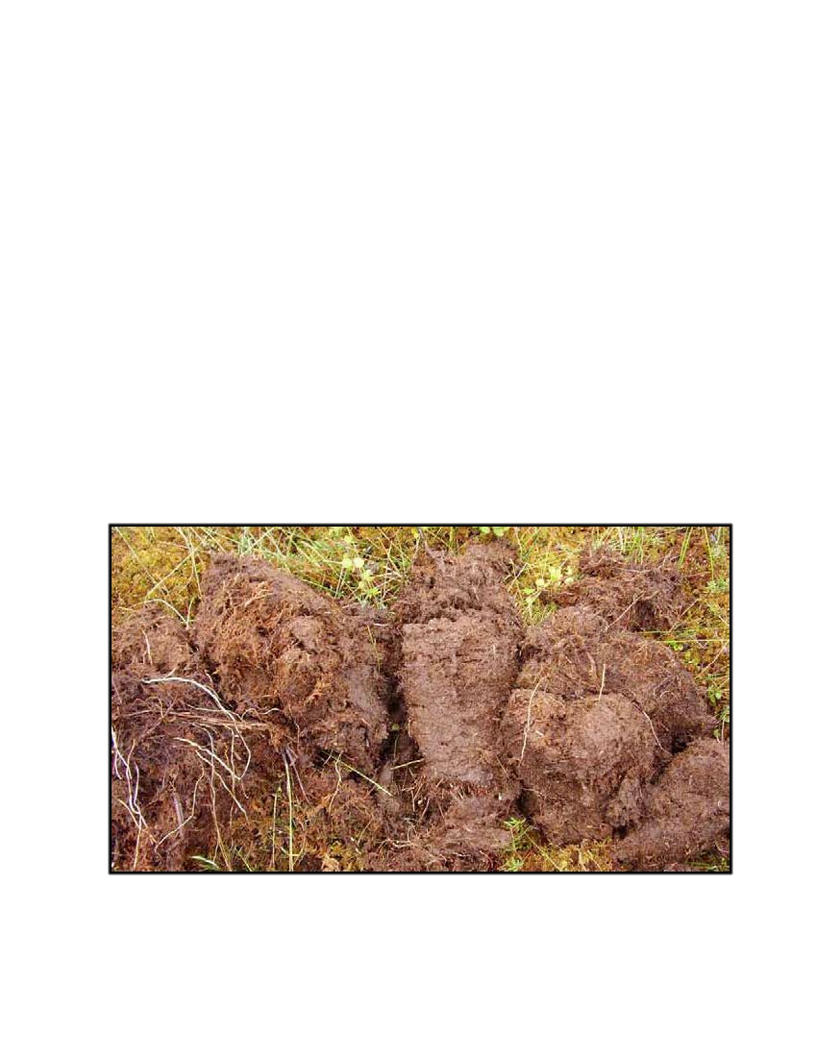
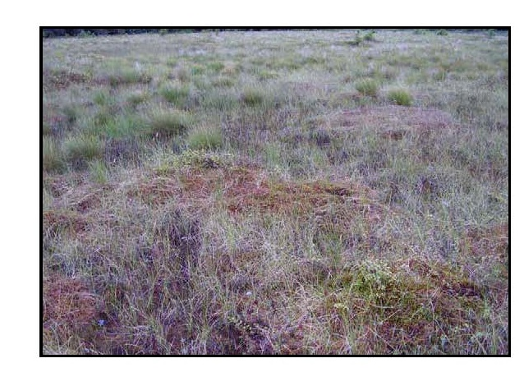
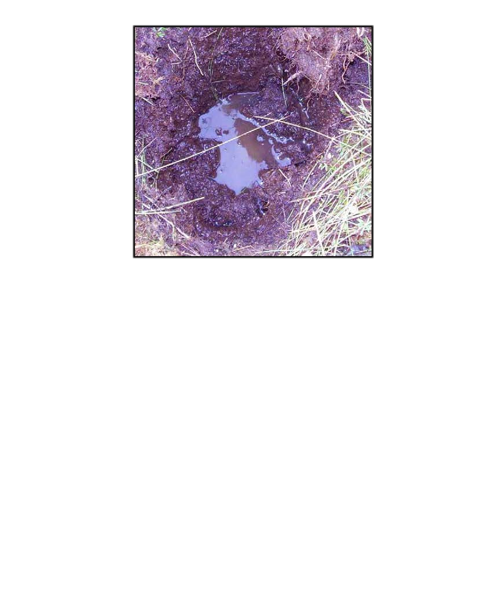
Wetlands Delineation, Functions, and Values Assessment
Notes:
Field delineation by a Professional Wetlands Scientist certification
USACOE wetlands delineation manual, AK region
State of AK wetlands delineation manual

Slide 10
Wetlands Delineation, Functions, and Values Assessment
Notes:
Overlay to visualize delineated wetlands in respect to project

Slide 11
Wetlands Delineation, Functions, and Values Assessment
Notes:
Relative Ecologic Value (REV), required to calculate project debits for compensatory mitigation

Slide 12
Jurisdictional Determination
Notes:
Lead agency requests JD from USACOE

Slide 13
Scoping
Notes:
Scoping is the term DOT&PF uses to describe early
EA activities that engage agencies and the public in:
• Determining the scope of environmental issues to
be addressed
• Identifying the alternatives and measures that may
mitigate adverse environmental impacts
• Identifying other environmental requirements that
should be performed concurrently with the enviro doc

Slide 14
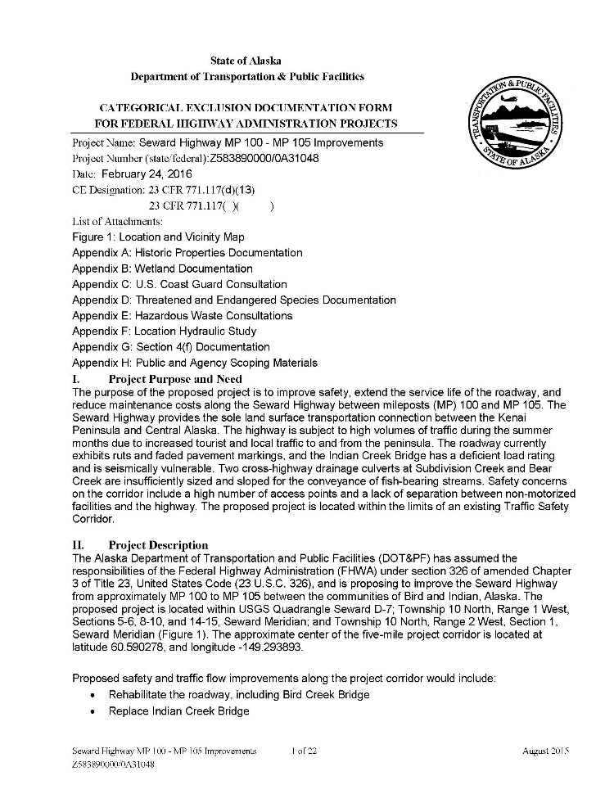
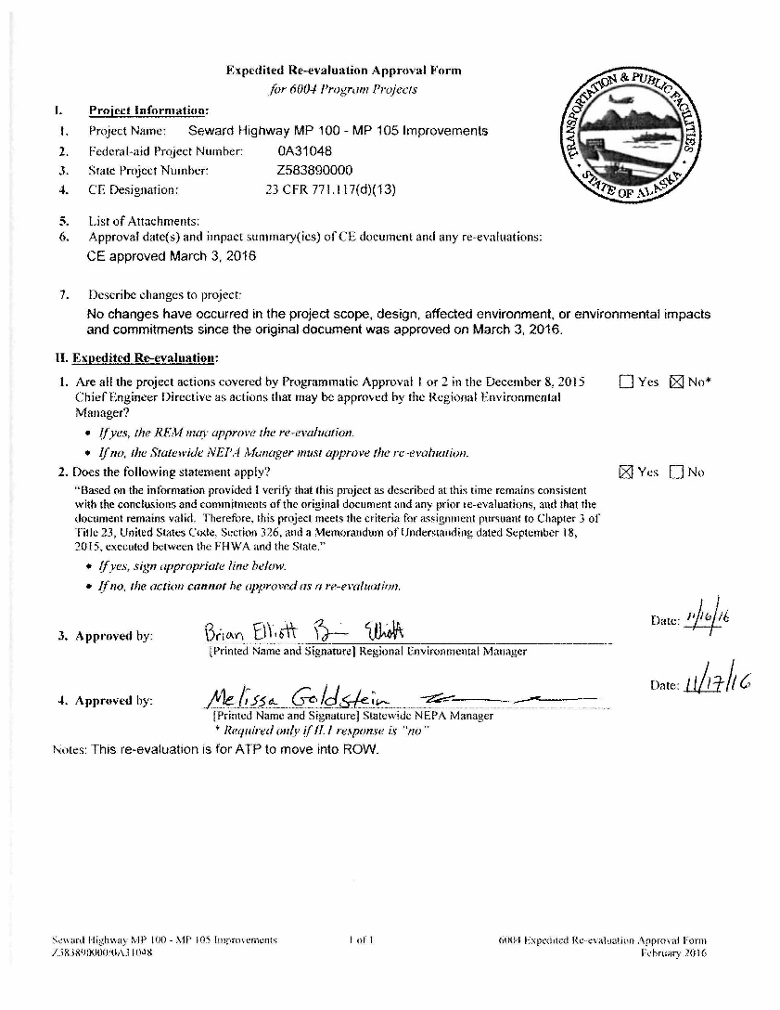
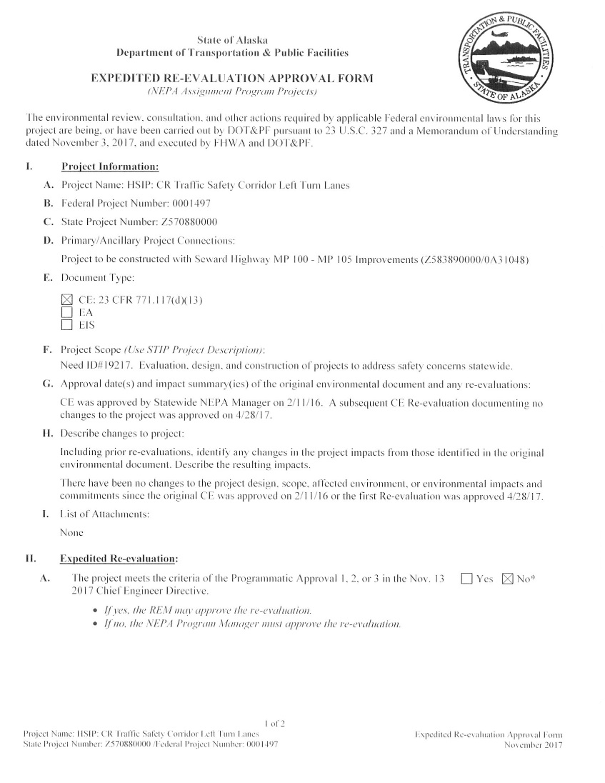
Environmental Document
Re-evaluation 2
Re-evaluation 1
Original CatEx
Notes:
For this example project: first CatEx: 2011
Rescoped in 2014, new CatEx in 2016
Re-evaluations in 2017 and 2019
Advertised for construction bids in 2019
Construction 2020-2021

Slide 15
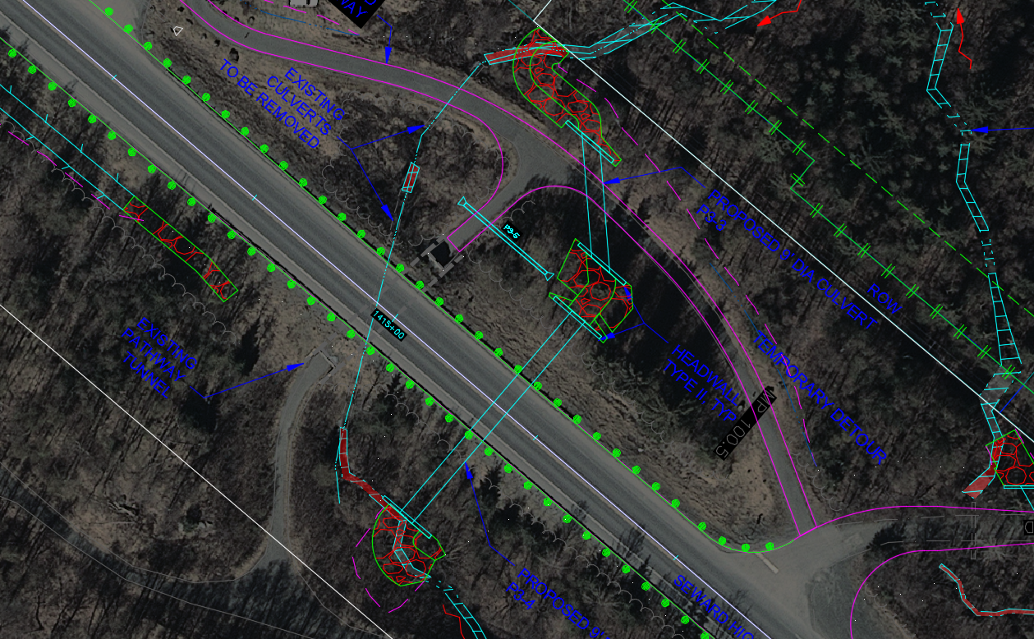
Quantify Impacts

Slide 16
Quantify Impacts

Slide 17
Quantify Impacts

Slide 18
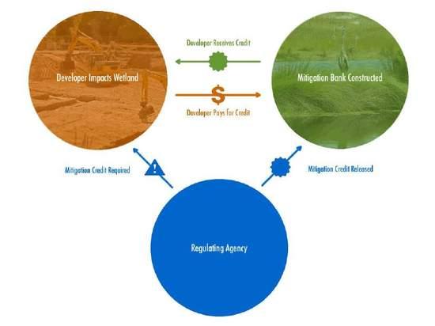
Mitigation
Nationwide general conditions
Avoiding
Minimizing
Rectifying
Reducing
Compensatory
https://ribits.usace.army.mil/ribits_apex/f?p=107:2
Notes:
Acronyms: LEDPA, RIBITS
Mitigation will be required to the extent necessary to ensure that the individual and cumulative adverse environmental effects are no more than minimal.
I’d like to focus on avoiding and compensatory

Slide 19
Compensatory Mitigation
Notes:
Compensatory mitigation is identified during permit review
The prospective permittee is responsible for proposing an appropriate compensatory mitigation option if compensatory mitigation is necessary to ensure that the activity results in no more than minimal adverse environmental effects. For the NWPs, the preferred mechanism for providing compensatory mitigation is mitigation bank credits or in-lieu fee program credits
Mitigation banking: Producers can buy credits from wetlands mitigation banks to compensate for the impact of lost wetlands. Wetland mitigation banks are established through the restoration, creation or enhancement of wetlands. When a mitigation bank is established, the landowner retains ownership and use of the property, while a conservation easement protects the wetlands from degrading activities.
Bank sponsors develop mitigation banks. A bank sponsor is any individual or entity that develops wetlands for use in wetland mitigation banking. The sponsor is responsible for the cost of wetland development, as well as long-term maintenance to ensure that the wetland continues to function as designed in the future.
Credits are determined using a functional assessment procedure that evaluates individual wetland functions. As the credits are sold, they are subtracted from the bank until all of the available credits are purchased. At this time, the mitigation bank closes and no additional credits can be sold from that bank.

Slide 20
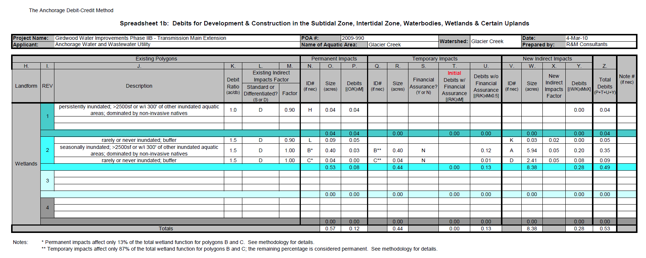
Compensatory Mitigation
Notes:
$84,901 was paid to the Great Land Trust for 0.53 credits

Slide 21
Finally – Permit!
Notes:
10 weeks from application to permit

Slide 22
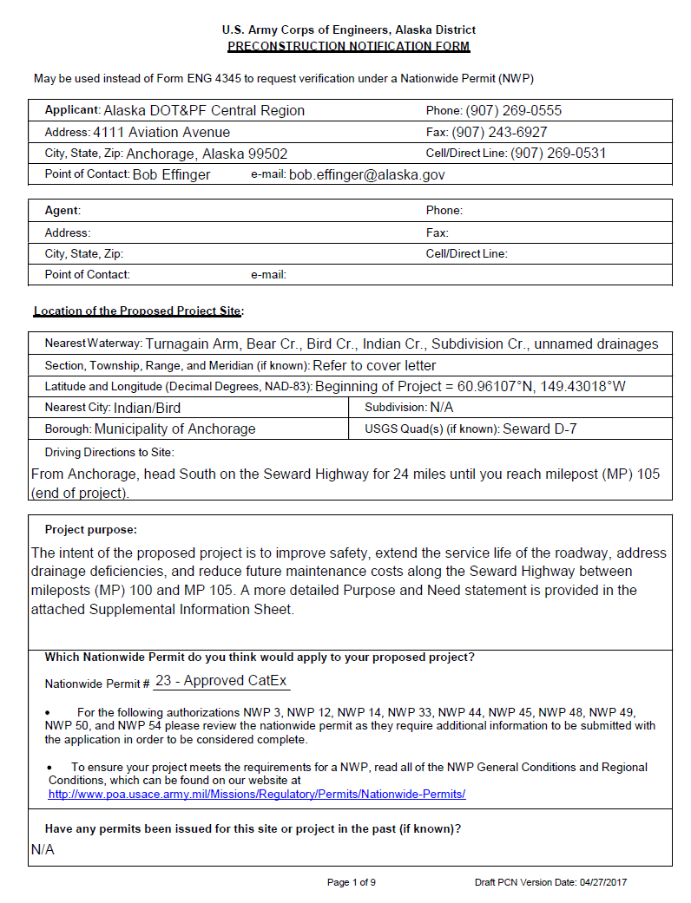
Preconstruction Notification/Close-Out

Slide 23
References
USACOE: https://www.poa.usace.army.mil/
DOT&PF: http://dot.alaska.gov/stwddes/desenviron/index.shtml
FHWA: https://www.environment.fhwa.dot.gov/default.aspx
NWI: https://www.fws.gov/wetlands/
MOA: http://anchoragestormwater.com/maps.html
Example project: http://sewardhighway100-105.com/

Slide 24
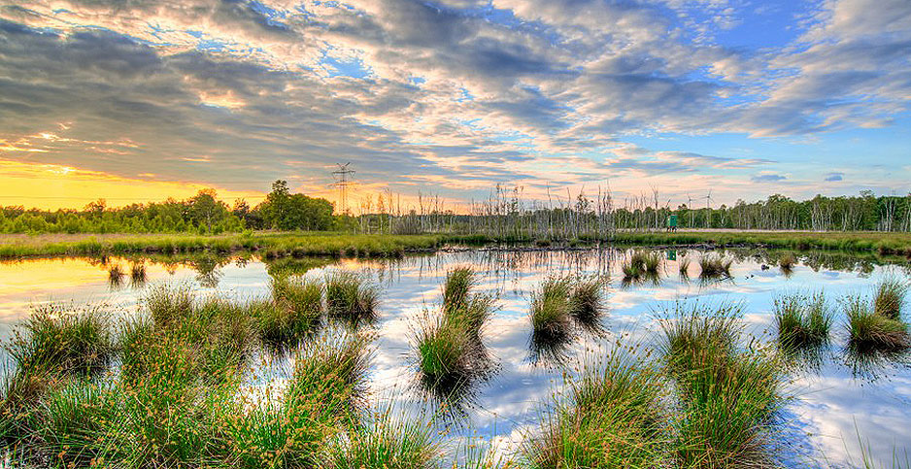
Questions/Comments?
Thank you

